Slide 1
Comparing Text Prediction Output: RWKV and BERT(fine-tuned models) vs. ChatGPT
Sumitra Shrestha and Gwyneth Cross
SIUE Department of Computer Science

Slide 2
01
Motivation and Research Aims

Slide 3
Motivation and Research Aims
- Accurate text prediction is crucial for various applications, including natural language understanding, chatbots, and content generation.
-Understanding the strengths and weaknesses of different language models helps us make informed decisions.
-Better Performance: Focuses models on specific tasks for improved results.
-Research aims -advancement of text prediction techniques in language models
- input to our models is a sequence of tokens (text).
- goal is to predict the next token(s) in the sequence.

Slide 4
Bert vs. RWKV vs. ChatGPT
BERT (Bidirectional Encoder Representations from Transformers)
-transformer-based model.
-excellent for tasks like text classification, named entity recognition, sentiment analysis, and text similarity.
-captures deep context understanding by processing text bidirectionally.
RWKV (blend RNNs and Transformers for efficient sequential data processing)
-also based on transformers.
-ideal for chatbots, virtual assistants, and any application requiring natural-sounding human text.
-sequential text generation allows it to engage in conversations.
ChatGPT (Generative Pre-trained Transformer)
- based on the GPT-3 model, which is a transformer decoder-only model.
-perfect for chatbots and virtual assistants.
-generates coherent and contextually relevant responses in a conversational style.

Slide 5
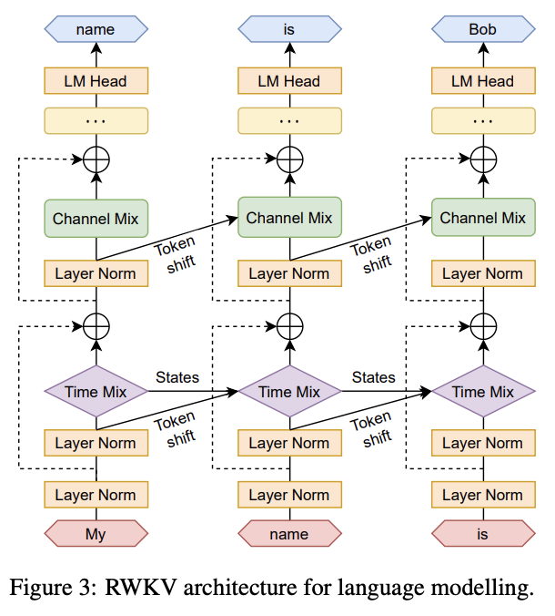

Slide 6
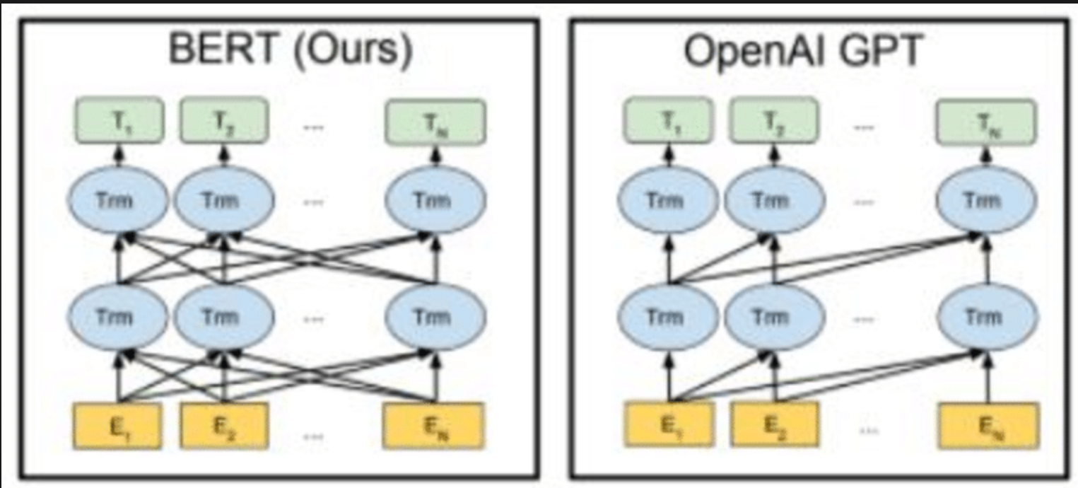

Slide 7
02
Related Work

Slide 8
Related Work
Can ChatGPT Understand Too? A Comparative Study on ChatGPT and Fine-tuned BERT[1] -ChatGPT excels in inference tasks but struggles with paraphrase and similarity.
-Despite proficiency, ChatGPT may generate contradictory or unreasonable responses. Benchmarking large language models’ performances for myopia care: a comparative analysis of ChatGPT-3.5, ChatGPT-4.0, and Google Bard[2]
-ChatGPT-4.0 excels, with 80.6% ‘good’ responses. All models self-correct effectively. How to Fine-Tune BERT for Text Classification?[3]
-explores fine-tuning methods for BERT, emphasizing pre-training on task-specific data and multi-task learning.

Slide 9
Related Work
ChatGPT v.s. Media Bias: A Comparative Study of GPT-3.5 and Fine-tuned Language Models[[4]
-ChatGPT performs well in some areas (hate speech, context bias) but struggles with subtle biases (fake news, racial, gender, cognitive)
A Comparison of ChatGPT and Fine-Tuned Open Pre-Trained Transformers (OPT) Against Widely Used Sentiment Analysis Tools: Sentiment Analysis of COVID-19 Survey Data[5]
-ChatGPT achieved a 6% higher accuracy than OPT and improvement of 4% to 7% in F-measure.
-Gaps in contextual awareness could impact performance.

Slide 10
03
Dataset and Features

Slide 11
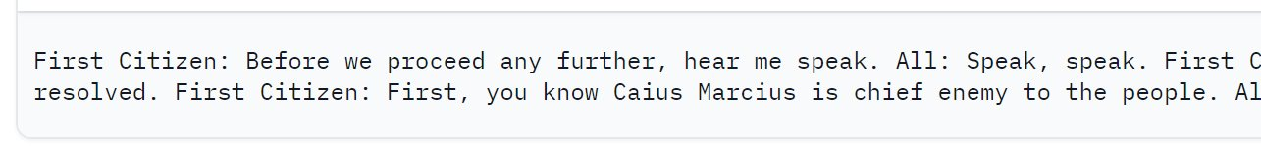
Tiny Shakespeare
40,000 lines of text from Shakespeare plays
Size: 1.11 MB
Train, test, and validation sets each have 1/3 of the text
The dataset is formatted like one long string, with \n indicating the beginning of a new line of dialogue
Source: https://huggingface.co/datasets/karpathy/tiny_shakespeare

Slide 12
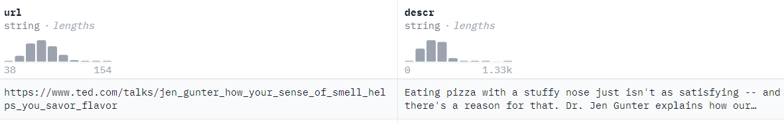
TED descriptions
Size: The dataset contains between 1,000 and 10,000 descriptions(1.67 MB.).
Source: The dataset was collected from TED's website.
Features: Consists of a URL (presumably linking to the corresponding TED talk) and a description of the talk.
Source: https://huggingface.co/datasets/gigant/ted_descriptions

Slide 13
04
Methods

Slide 14
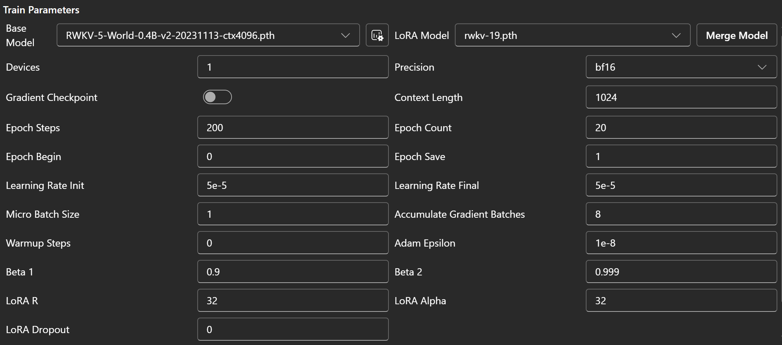
RWKV Fine-Tuned Model Parameters
LoRA: Low-Rank Adaptation of Large Language Models; https://arxiv.org/abs/2106.09685

Slide 15
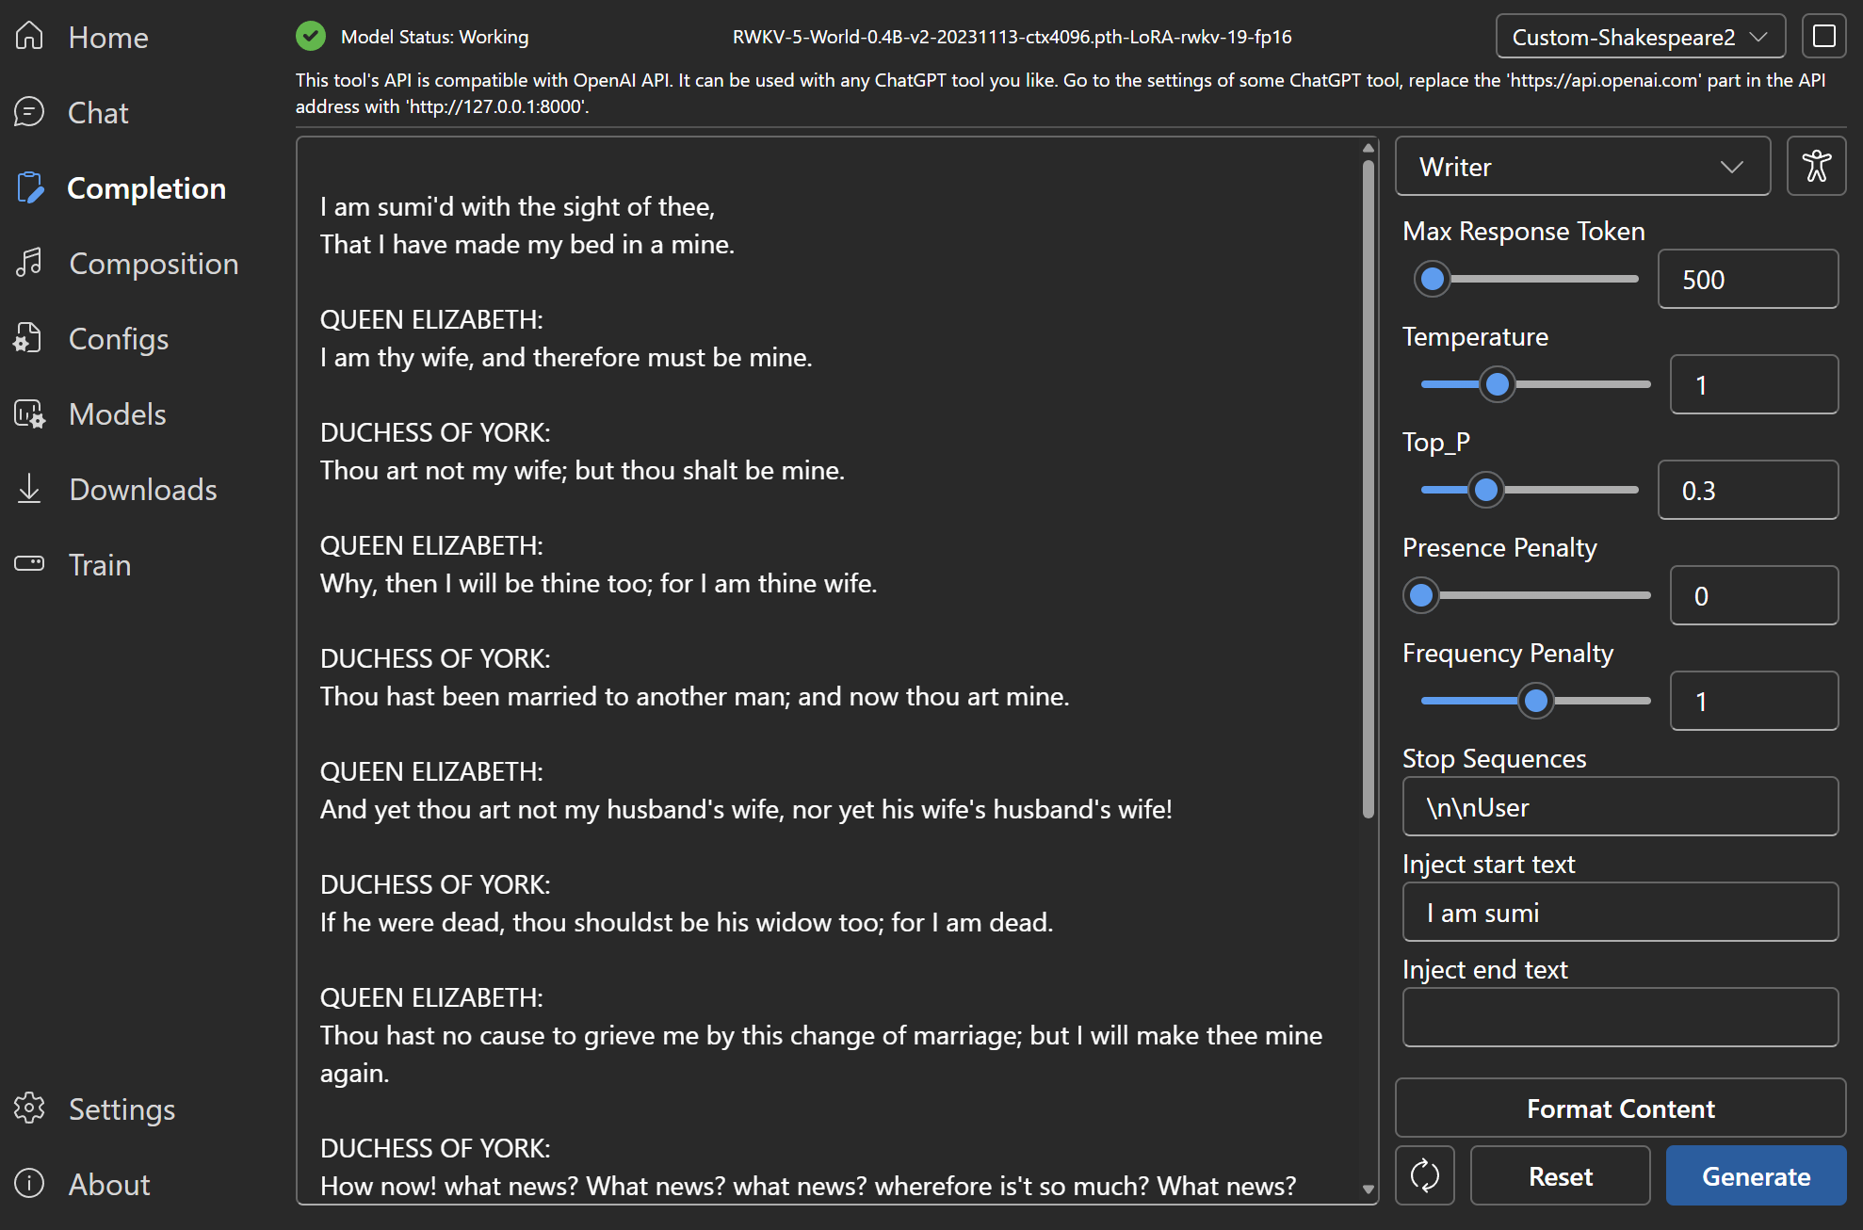

Slide 16
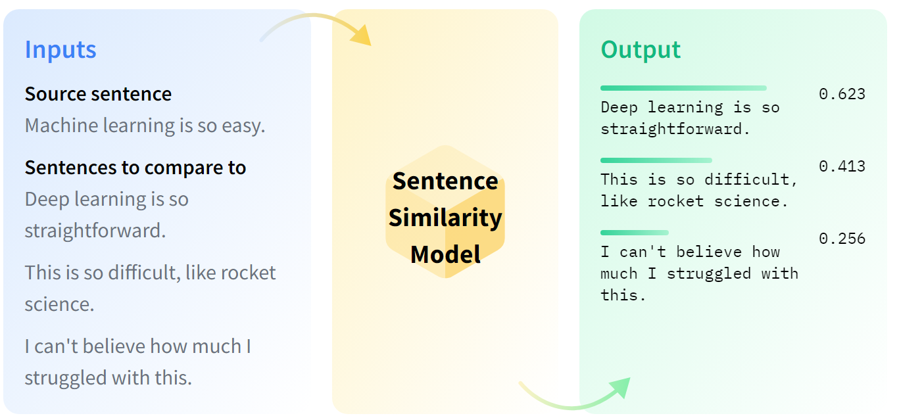
Sentence Similarity
Uses word vectors to create a numerical measure of the similarity between words in two texts
Source: https://huggingface.co/tasks/sentence-similarity

Slide 17
05
Results

Slide 18
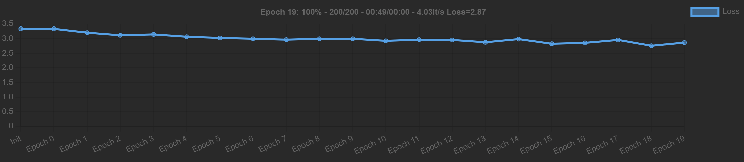
RWKV Model Loss

Slide 19
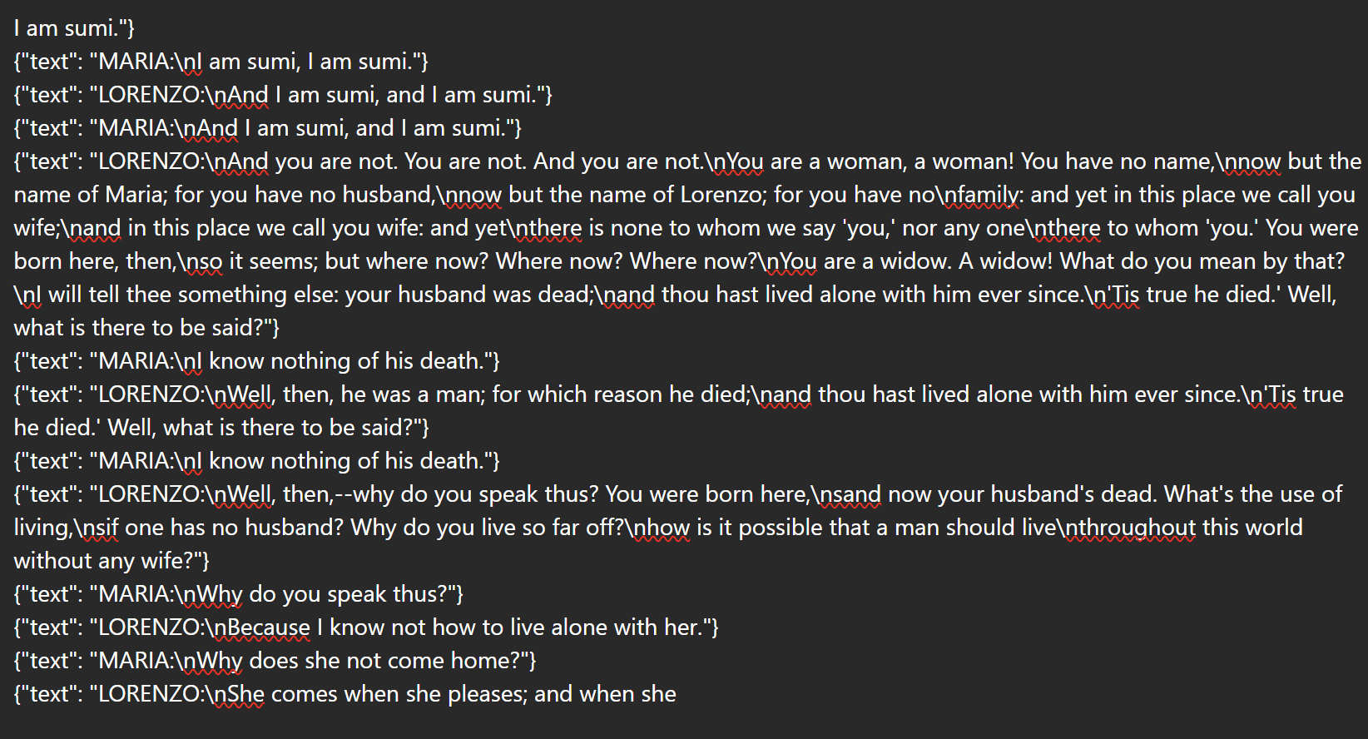
RWKV Results

Slide 20
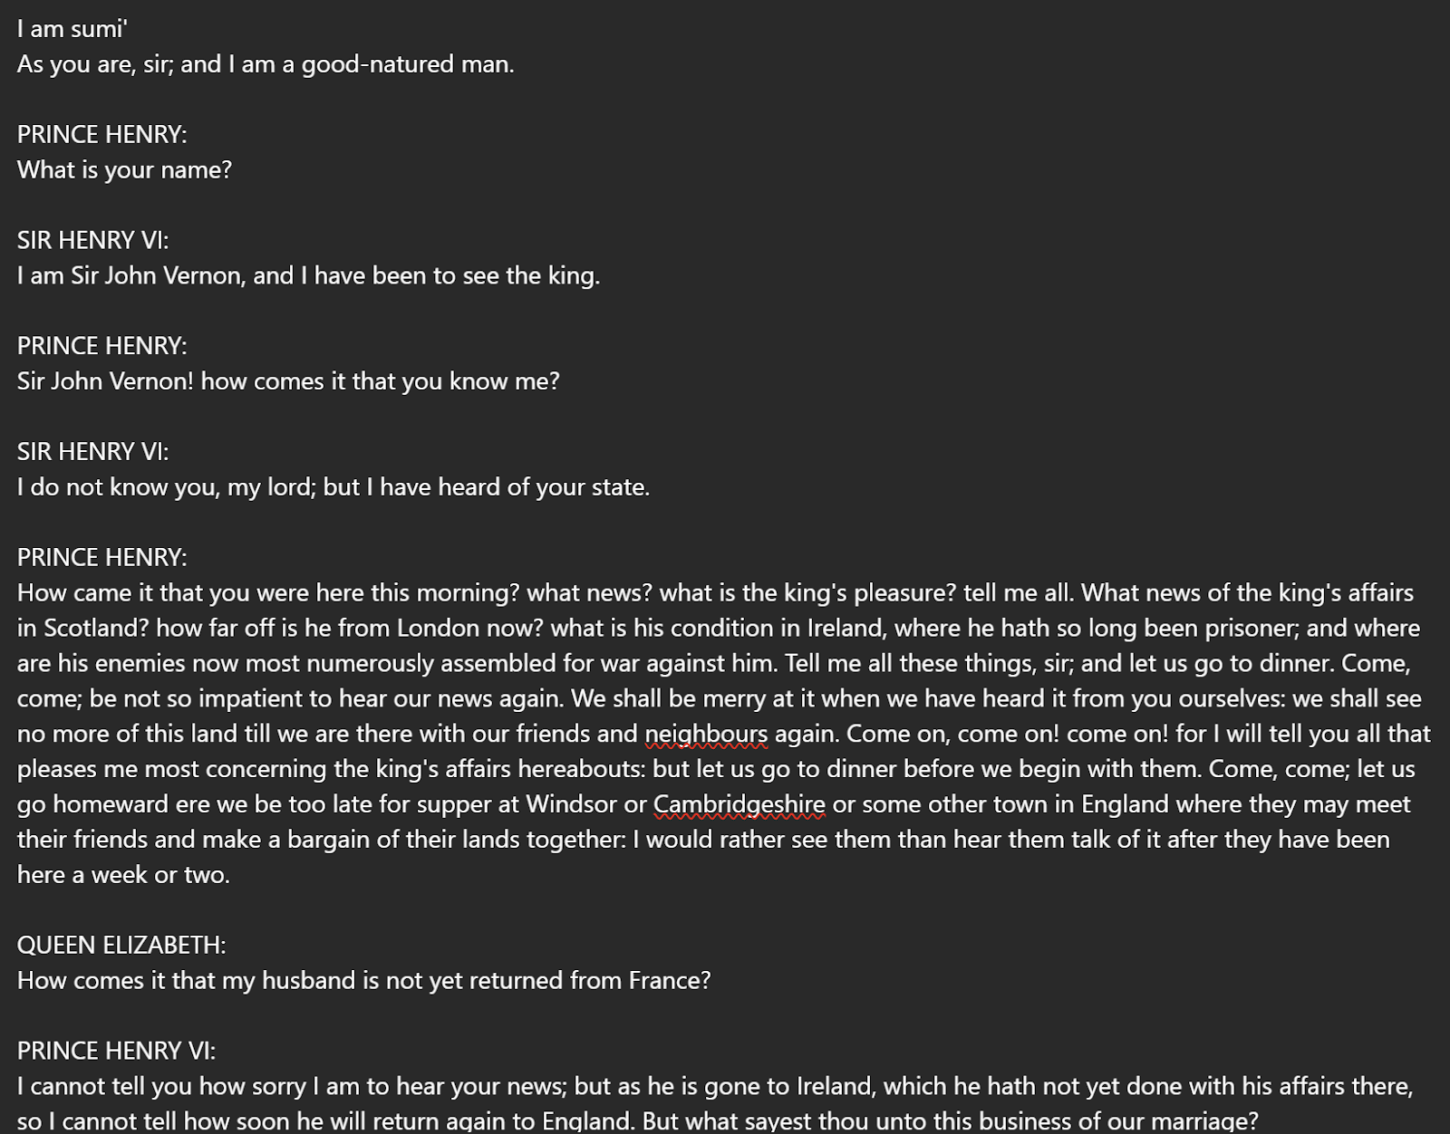
RWKV Results

Slide 21
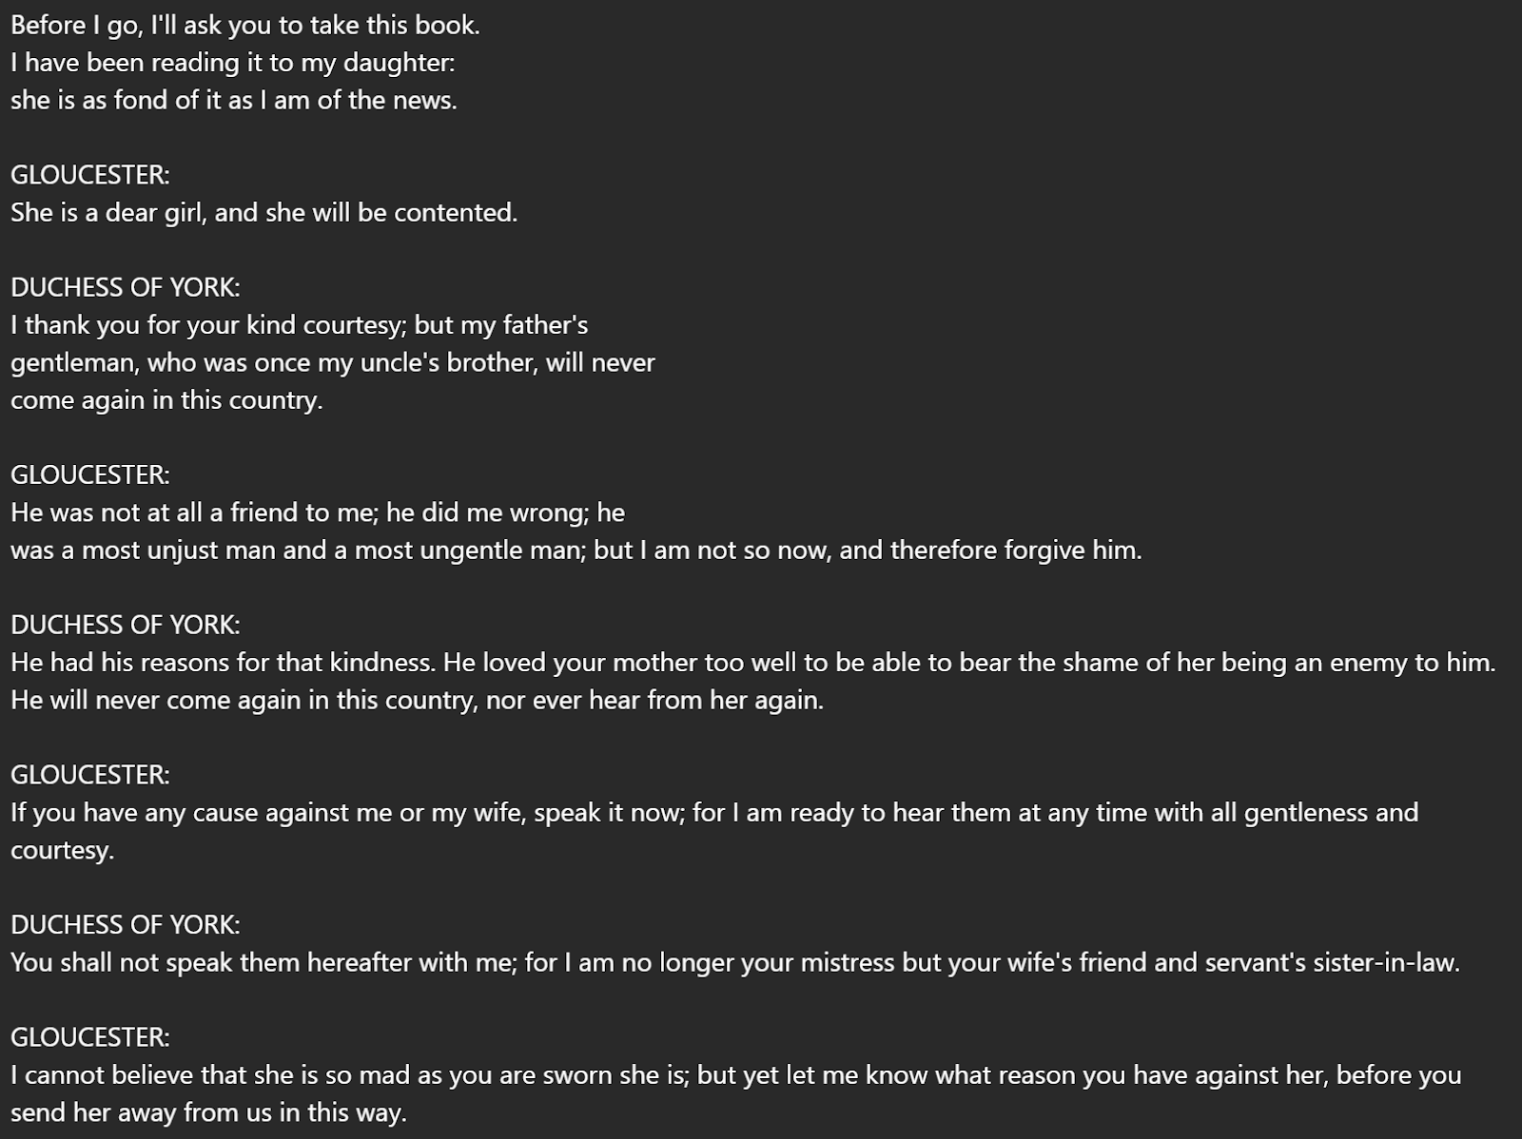
RWKV Results

Slide 22

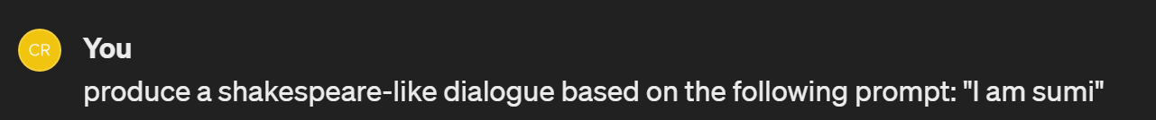
ChatGPT Results

Slide 23
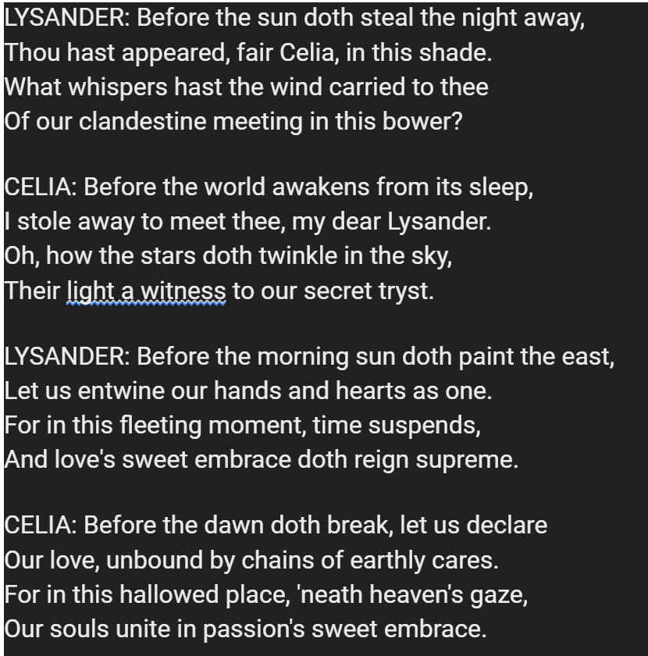
ChatGPT Results

Slide 24
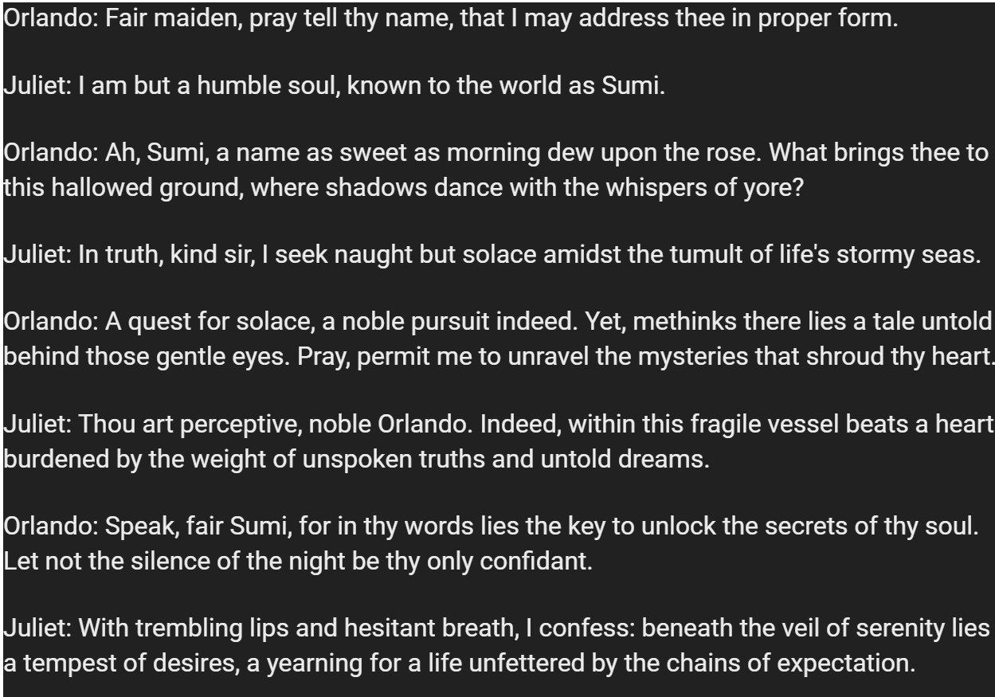
ChatGPT Results

Slide 25
Semantic Similarity
Prompt | Semantic Similarity
"I am sumi" | 0.849
"Before" | 0.838

Slide 26
Limitations
Lack of access to GPT's proprietary API means that model can't be fine-tuned, only prompted
Hardware limited the maximum size of the RWKV model to one trained on 0.4 Billion data points (RWKV-4) vs. the most updated version trained on 3 Billion data points (RWKV-6)

Slide 27
BERT Workflow
Load the "tiny_shakespeare" and "ted description " dataset and tokenize it with the BERT tokenizer, converting text into token IDs and masking tokens for the task.
Initialize BERT for masked language modeling using the pre-trained "bert-base-uncased" checkpoint.
Set up the AdamW optimizer to update model parameters during training.
Iterate over different hyperparameter combinations, such as learning rates and batch sizes, to optimize model performance.
Train the model for a fixed number of epochs for each combination.

Slide 28
BERT Workflow
Train the model by iterating over preprocessed data batches using a DataLoader.
Compute the loss based on masked tokens and actual labels, perform backpropagation, and update model parameters with the optimizer.
Compute perplexity by iterating over data batches, generating logits, and using the calculate_perplexity function.
Select the best-performing model based on the lowest average perplexity across different hyperparameter settings.
Define a function to generate text continuation using the selected fine-tuned model, based on a given prompt.

Slide 29
Masked Language Modeling (MLM)
Objective: Train a language model to understand the context of words and sentences by predicting masked tokens within a given text.
Pretraining Phase:
Input text is tokenized and a certain percentage of tokens are randomly replaced with a special [MASK] token.
The model predicts the original tokens based on the context provided by the surrounding words.

Slide 30
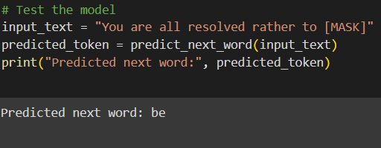
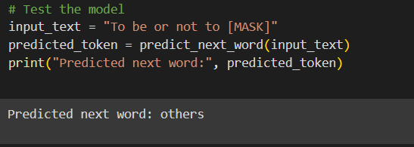
BERT Workflow
-Attempted to modify the masking strategy
-Instead of masking random words:
-specifically mask next word in each sequence during training.
-this would force model to predict next word based on preceding context:
- making it more relevant to next word prediction task.
# Mask the next word
masked_index = len(tokenized_text) - 1
tokenized_text[masked_index] = '[MASK]'

Slide 31
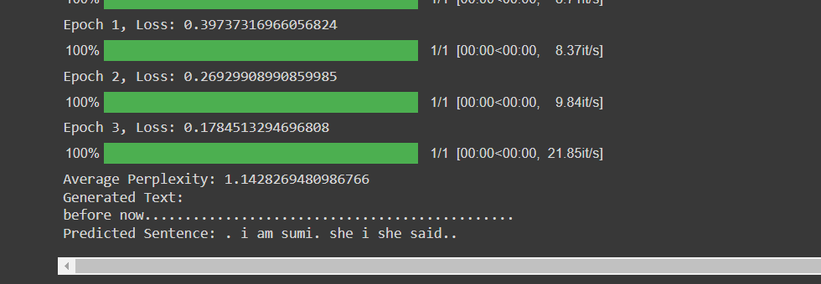
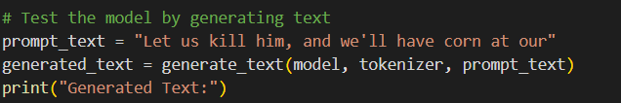
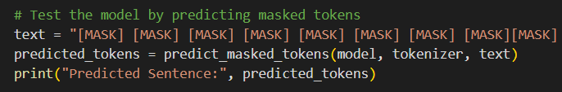
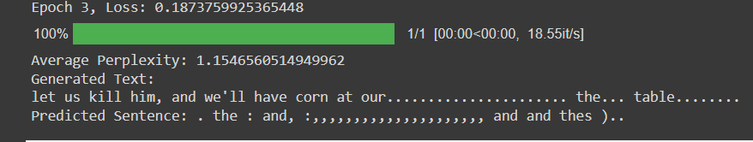
BERT Result

Slide 32
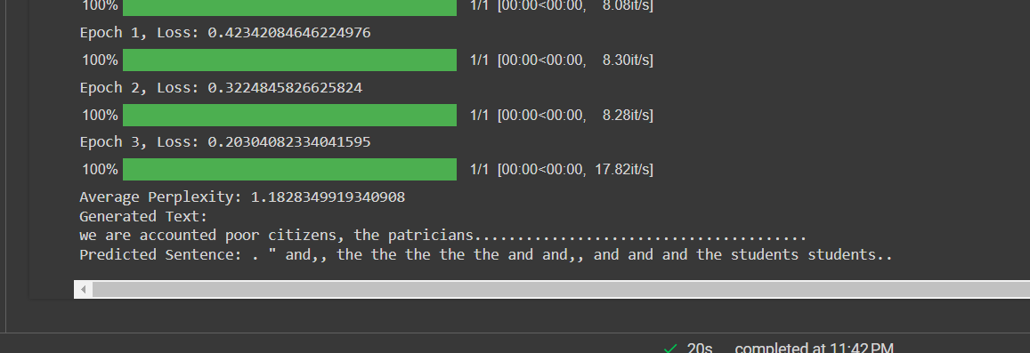
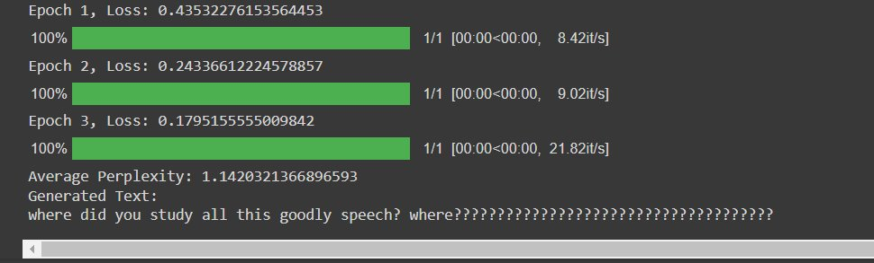
BERT Result
-perplexity measures how well a language model predicts a given piece of text

Slide 33
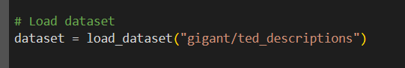
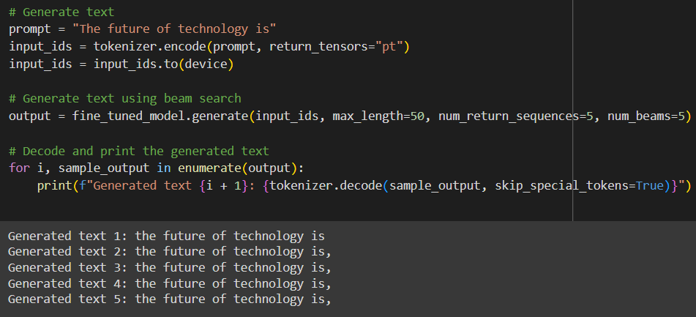
BERT Result

Slide 34
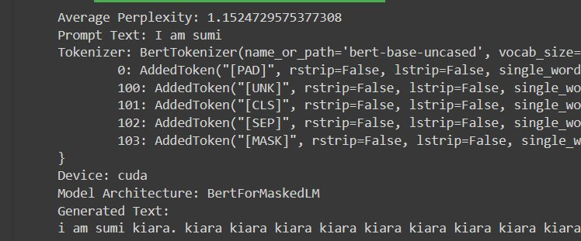
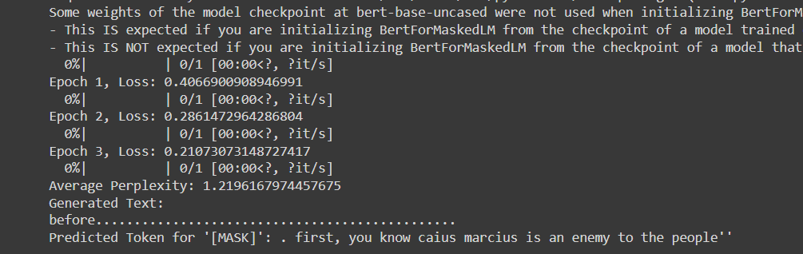
BERT Result

Slide 35
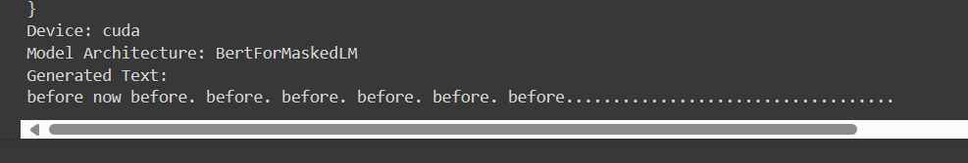
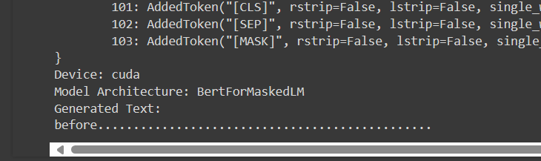
BERT Result

Slide 36
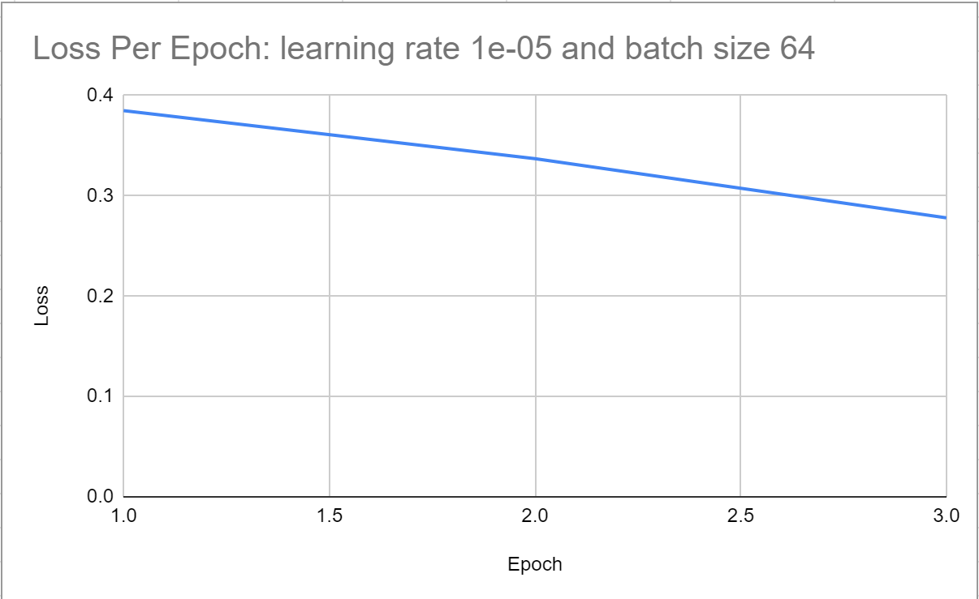
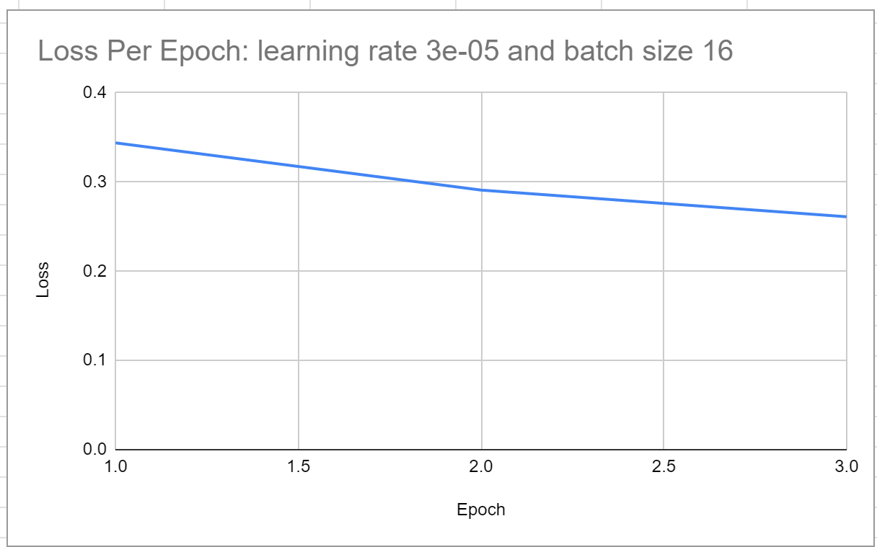
BERT Results

Slide 37
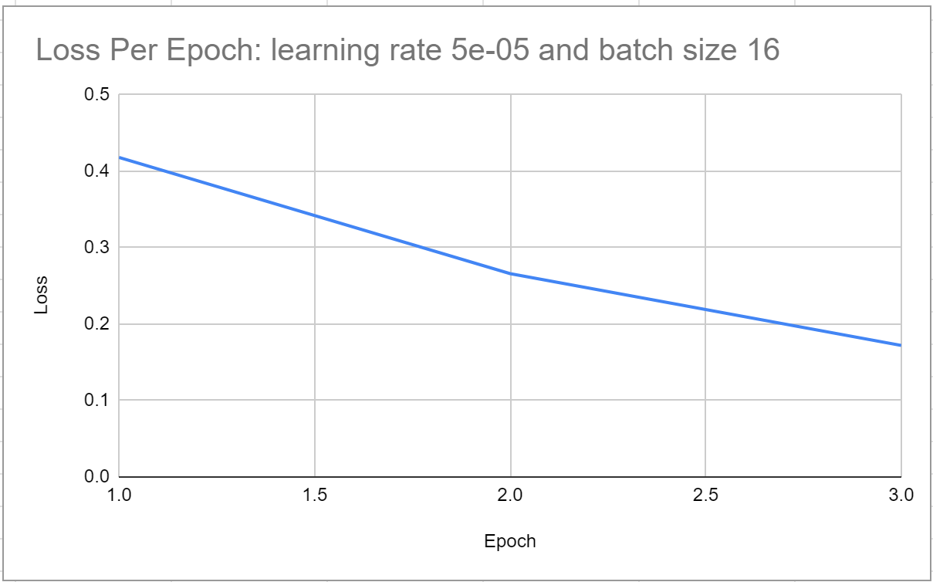
BERT Results

Slide 38
ISSUES
For generating next word or even full sentences
- it faces obstacles such as tokenizer limitations and the issue of hallucination.

Slide 39
06
Conclusion and Future Work

Slide 40
Conclusion and Future Work
Gain access to GPT-3 API to directly fine-tune the model
Could produce results more similar to the RWKV results
Continue working to produce reasonable text output with BERT
Test results with larger RWKV models to see if the results are improved
Use transformer-based decoder in BERT for generation purpose.

Slide 41
Thank You!
Questions?

Slide 42
Citations
[1] Zhong, Q., Ding, L., Liu, J., Du, B., & Tao, D. (2023). Can chatgpt understand too? a comparative study on chatgpt and fine-tuned bert. arXiv preprint arXiv:2302.10198.
[2] Lim, Z. W., Pushpanathan, K., Yew, S. M. E., Lai, Y. Y., Sun, C.-H., Lam, J. S. H., … & Tham, Y.-C. (2023). Benchmarking large language models’ performances for myopia care: a comparative analysis of ChatGPT-3.5, ChatGPT-4.0, and Google Bard1. EBioMedicine, 95, 104770. https://doi.org/10.1016/j.ebiom.2023.104770
[3]Sun, C., Qiu, X., Xu, Y., Huang, X. (2019). How to Fine-Tune BERT for Text Classification?. In: Sun, M., Huang, X., Ji, H., Liu, Z., Liu, Y. (eds) Chinese Computational Linguistics. CCL 2019. Lecture Notes in Computer Science(), vol 11856. Springer, Cham. https://doi.org/10.1007/978-3-030-32381-3_16
[4]Wen, Z., & Younes, R. ChatGPT vs Media Bias: A Comparative Study of GPT-3.5 and Fine-tuned Language Models.
[5]Lossio-Ventura J, Weger R, Lee A, Guinee E, Chung J, Atlas L, Linos E, Pereira F
A Comparison of ChatGPT and Fine-Tuned Open Pre-Trained Transformers (OPT) Against Widely Used Sentiment Analysis Tools: Sentiment Analysis of COVID-19 Survey Data JMIR Ment Health 2024;11:e50150 URL: https://mental.jmir.org/2024/1/e50150 DOI: 10.2196/50150

